Slide 1
An Unequal Dream
The Gap in Homeownership for White and Black Americans
By Michael Nicholson

Slide 2
The Gap in Homeownership

Slide 3
Homeownership by Race

Slide 4
Data

Slide 5
HDMA LAR Data
Home Mortgage Disclosure Act
Enacted in 1975
Requires financial institutions to provide mortgage data to the public
Loan Application Register
Loan level data released annually
Includes data on race, ethnicity, income, type (conventional loan, FHA loan, VA loan, etc.), amount, action taken, reason denied (if applicable), etc.
Dodd-Frank
Beginning in 2018, the required characteristics in LAR data was expanded
These new data points include credit score, DTI, LTV, age, fees, interest rate and expanded information on commercial and business loans
Credit scores are stripped from publicly released versions of the data to protect the autonomy of the borrower

Slide 6
Results

Slide 7
Before adjustment, predominately black neighborhoods face rate spreads that are 52.5 basis points higher than non-black neighborhoods
This equates to approximately $950 a year in higher interest expense
Borrower and tract characteristics account for ~70% of this gap
This holds for any order of adding these variables to the regression
Geographic effects account for ~10%
This leaves 11.8 basis points I predominately attribute to loan pricing discrimination
This corresponds to 14.3% higher rate spreads for black neighborhoods

Slide 8
Past literature has shown that black borrowers are much more likely to use high-cost lenders
This necessitates the use of lender fixed effects
In contrast to past results, I find that county-level fixed effects largely encapsulate the lender fixed effects
This may result from the geographic effects capturing the geographic distribution of lenders
This is apparent in the identical Majority Black coefficient in specification 4 and 6
Adding the interaction of lender fixed effects and their market share does have a small impact, but .7 basis points has little economic significance in practice

Slide 9
Robustness

Slide 10
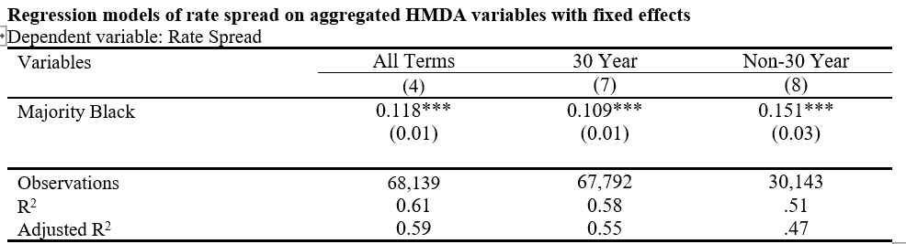
To compare my results to past studies utilizing only 30-year-loans, I reran my models using only data from 30 and non-30 year loans
Overall, the estimated loan pricing discrimination differential for 30 year loans and all loans is small
However, it does appear only considering 30-year loans slightly underestimates pricing discrimination
More notably, the differential between solely 30 and non-30 year loans is much larger at ~4 basis points
In of itself, this may not indicate greater rates of pricing discrimination in non-30 year loans since some features like adjusted-rate are not present in the model
This does, however, showcase yet another area for which black households face higher loan pricing
This is especially problematic if black borrowers are steered to these loan types

Slide 11
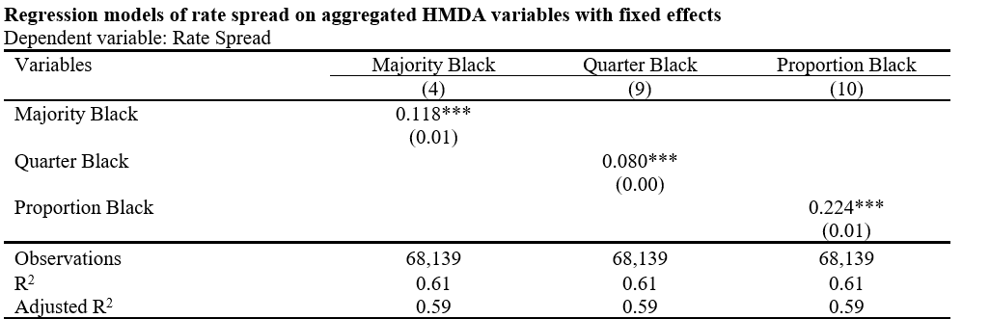
The Majority Black variable is heavily skewed with only 5% of tracts meeting the threshold of having over 50% black applicants
To check the robustness of using this as an explanatory variable, I reran the model using a binary variable for if over 25% of the applicants in a tract were black and a continuous black population variable
The results of these models are in line with economic intuition, with the Quarter Black tracts showing a smaller but significant estimate of pricing discrimination and the continuous variable also showing a significant estimate for pricing discrimination
Note: the Proportion Black coefficient can be interpreted as a 2.24 increase in expected rate spreads for a 10 percentage point increase in black applicants

Slide 12
Including the ACS variables decreases the estimation of pricing discrimination by 1.8 bps
This would suggest that omitting these tract-level variables introduces omitted variable bias to the model
In comparison to non-predominantly black neighborhoods, black neighborhoods have:
Lower rates of bachelor’s degree attainment (17.3% vs. 31.8%)
Higher rates of uninsured residents (31.8% vs. 13.1%)
Significantly higher rates of government subsidies (29.7% vs. 12.8%)
Higher unemployment rates (5.7% vs. 3.0%)
Higher vacancy rates (16.9% vs. 11.5%)

Slide 13
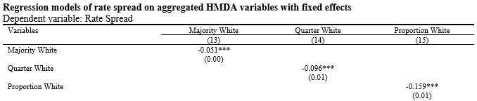
The coefficients on these variables are negative, indicating that white tracts receive a rate discount in comparison to tracts with more significant minority populations
This matches economic intuition that white borrowers receive preferential treatment compared to other races.
These results suggest that the model is robust across different races and is in line with the results of previous literature

Slide 14
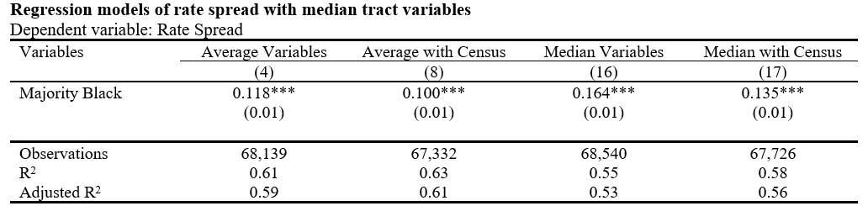
Estimated pricing discrimination using median values is approximately 3.5 basis points higher than when using average values
This would indicate that there is skew in the distribution of applicants
A small number of higher-quality borrowers in predominately black tracts hold down average rate spreads in these communities
This is in contrast to my initial intuition that weaker borrowers may be pushing up rate spreads in predominantly black tracts
These results suggest that pricing discrimination is even more pronounced for the median applicant than suggested by the baseline model
It is not a small subset of weaker black borrowers in predominantly black tracts that face pricing discrimination but a majority of all borrowers in these tracts

